Slide 1

The Environmental
Impact Dashboard
Green Gauge: Visualizing Environmental Impact
Team Members
Deeksha Singh
Jaanvi Saxena

Slide 2

Problem
Environmental Pollution is growing day by day which is impacting our quality of life as well as compelling us to take measures to prevent and conserve our valuable nature and it’s resources.
Every Individual is required to take significant steps towards the protection and conservation to save the resources from getting depleted .

Slide 3
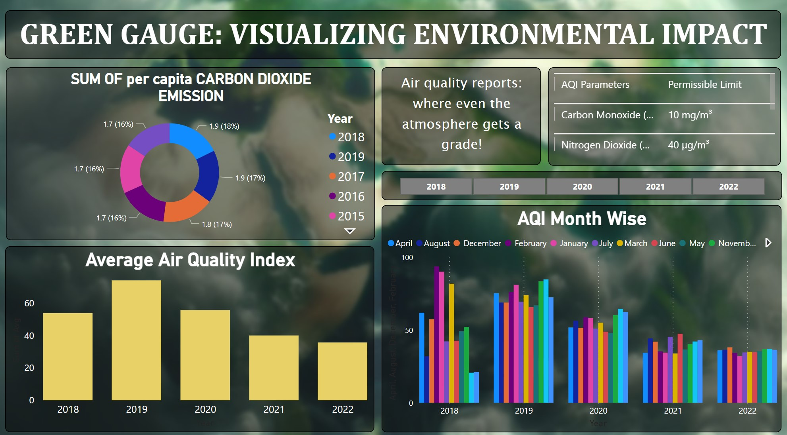
The Solution: Green Gauge
Our Environmental Impact Dashboard
Our Dashboard serves complex environmental parameters into easy to understand charts.
Individuals often lack the data to understand their impact, hence catering to the need.
Different Parameters are showcased to provide a diverse view of the scenario.
Notes:
Anecdotes: Fun highlights and tidbits from the year — the most used feature, the most liked social post, the most common request or question to support etc. Key learnings or takeaways to consider next year.

Slide 4
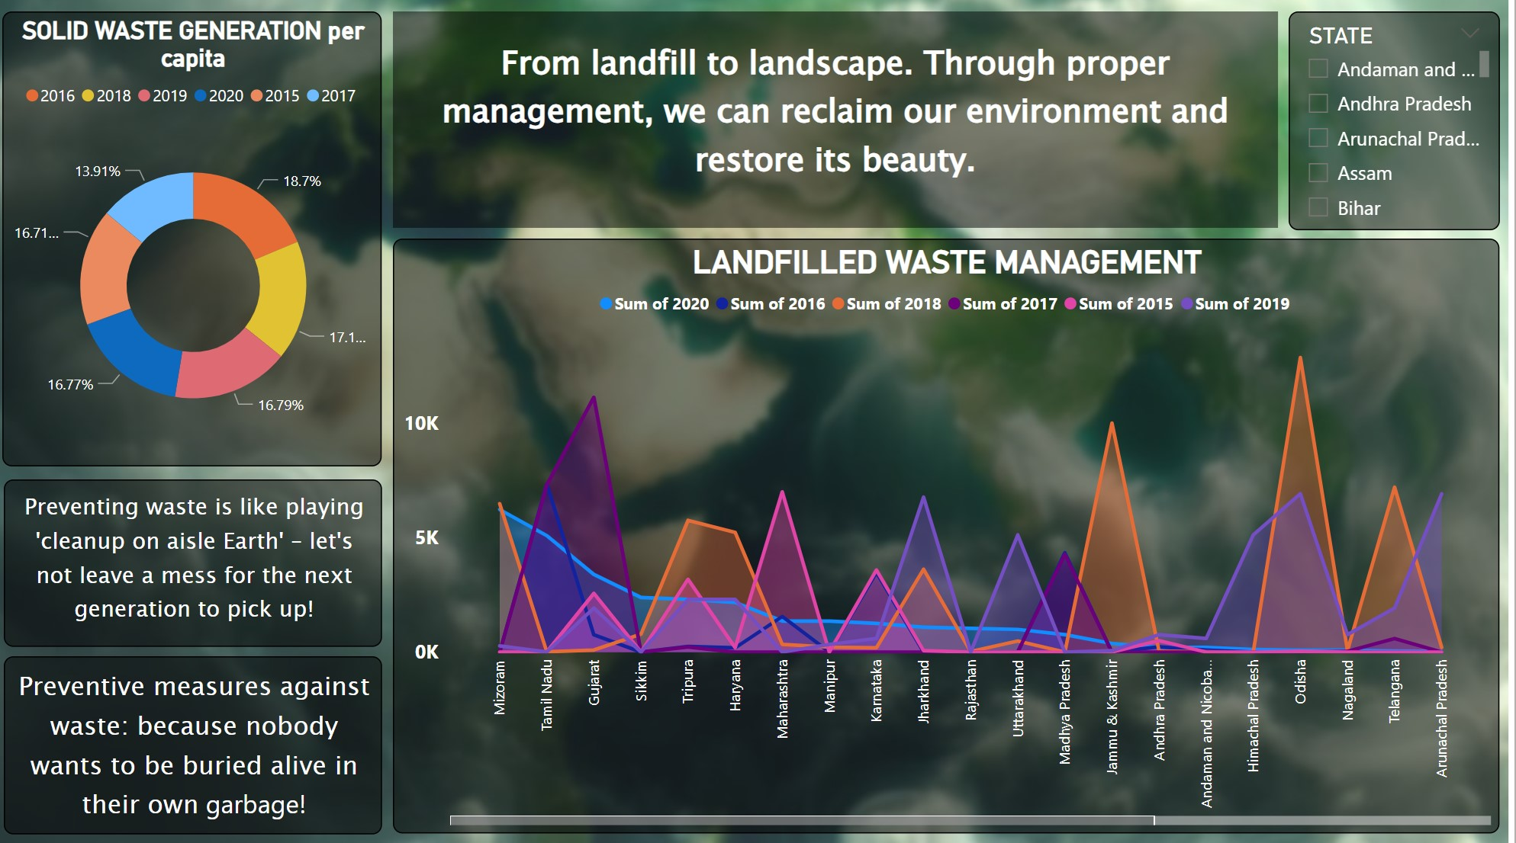
How it works
User-friendly interface allows for easy visualization with colorful charts.
Tracks a variety of environmental factors: AQI, Deforestation, waste generation
Integrates with existing data sources.
Monthly and yearly analysis done for India and also state wise data shown through years.

Slide 5
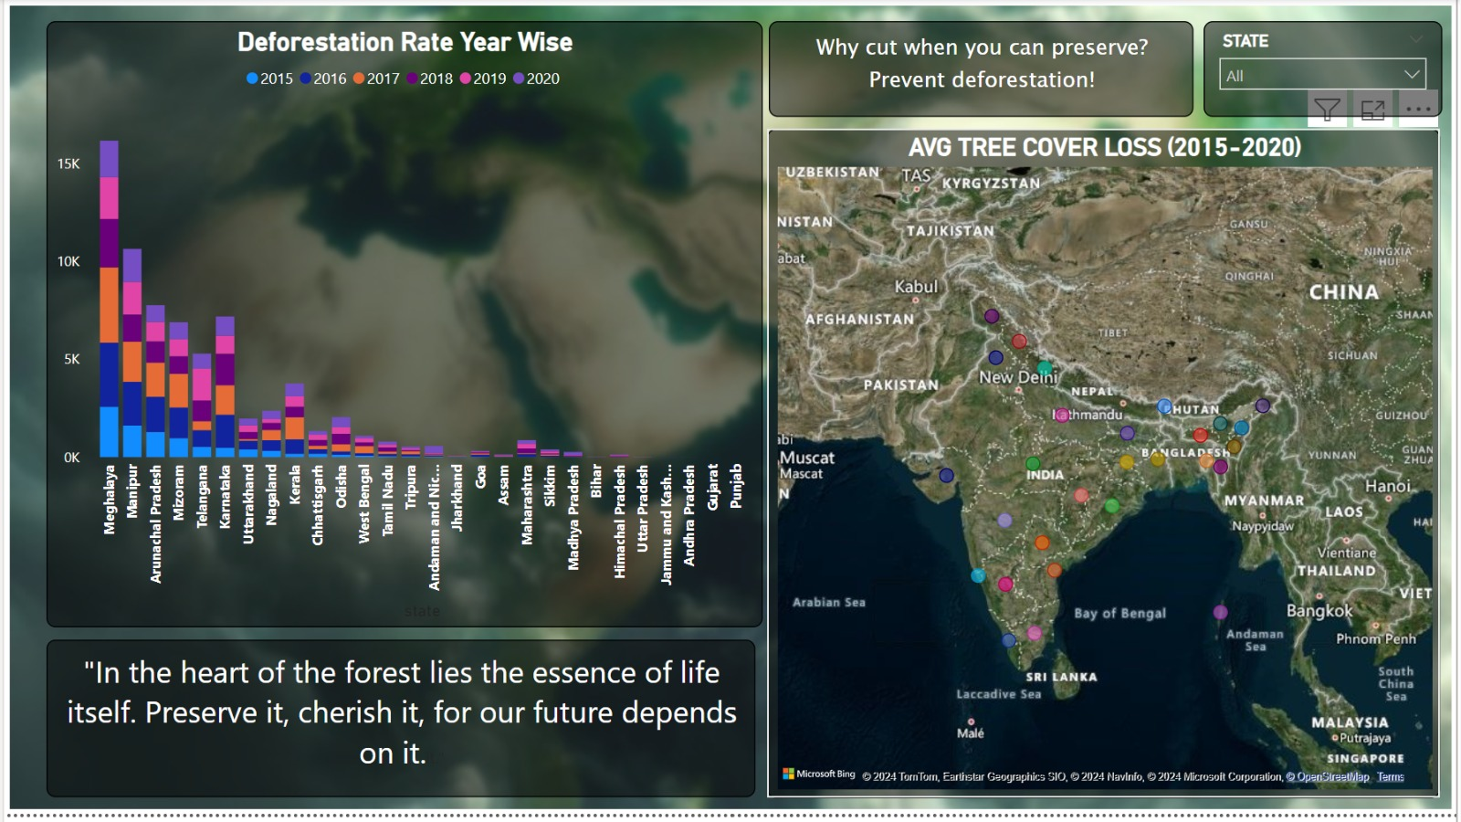
Actionable Insights
The dashboard translates data into clear, actionable insights
Identify areas for improvement and set achievable goals.

Slide 6

Solution Oriented
The dashboard is solution oriented , it shows solution such as landfill management to tackle waste generated.
It inspires the individuals towards conservation of environmental.
Motivates to take steps and create a positive impact on the earth.
Notes:
Anecdotes: Fun highlights and tidbits from the year — the most used feature, the most liked social post, the most common request or question to support etc. Key learnings or takeaways to consider next year.

Slide 7

Tool Used
and Experience
Built using Power BI: a user-friendly and powerful data visualization platform
Interactive dashboards and reports for a dynamic experience
Notes:
Anecdotes: Fun highlights and tidbits from the year — the most used feature, the most liked social post, the most common request or question to support etc. Key learnings or takeaways to consider next year.

Slide 8
Overview
Dynamic dashboard made by PowerBI highlighting all the important environmental parameters and its statistics.
Key Features
Dynamic charts
Graphs highlighting dispairities
Application of filters (slicers)
To make our
Community participation and ownership are essential for sustainable solutions.
Public spaces can be powerful tools for social transformation and economic development.
Notes:
Anecdotes: Fun highlights and tidbits from the year — the most used feature, the most liked social post, the most common request or question to support etc. Key learnings or takeaways to consider next year.

Slide 9
Thank you

